Slide 1

2026 SMU Cox NAPE Energy Innovation Case Competition​
Strategic Response to​
Dissident Investor Activism
JV/PPA with AWS | Nuclear-Powered Data Center Strategy​
Team Members
Anh Bui, Minh Nguyen, Cuong Nguyen

Slide 2
Company Background & Real-World Precedent​
OUR COMPANY​
REAL CASE: TALEN ENERGY (TLN)​
• 13,000 MW total capacity (Nuclear + Gas + Coal)​
• 2,200 MW nuclear plant — PJM RTO
• $20B market cap | 45M shares | $444/share​
• 30x EV/EBITDA | BB credit rating​
• 9% dissident investor → 10% = special meeting​
• Target: 30% Adj FCF/share growth​
• 13,100 MW capacity — nearly identical fleet​
• 2,500 MW Susquehanna nuclear — PJM RTO​
• Sold Cumulus DC to AWS for $650M (Mar 2024)​
• 20-year nuclear PPA with AWS through 2042+​
• Stock: $60 → $389 — 6.5x appreciation​
• Market cap: $3B → $17.6B post-deal​

Slide 3
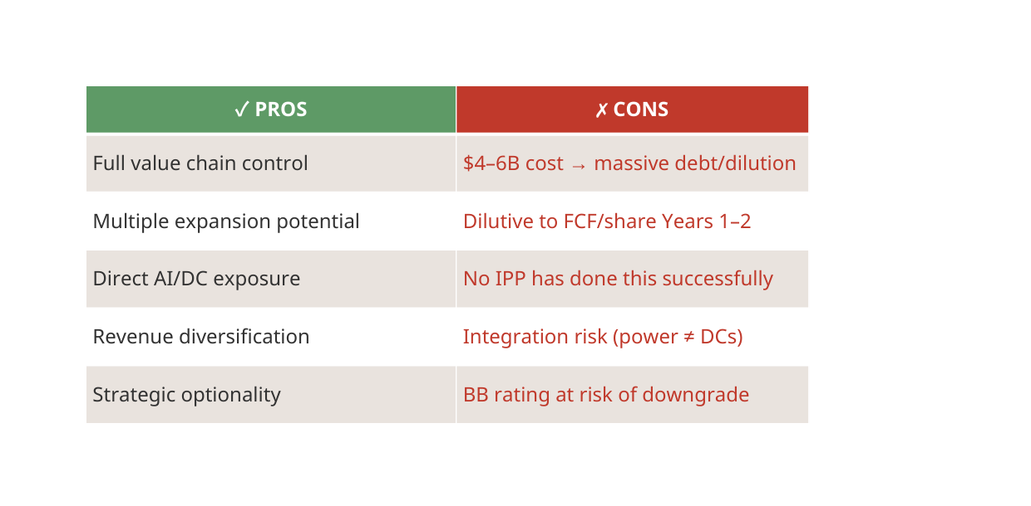
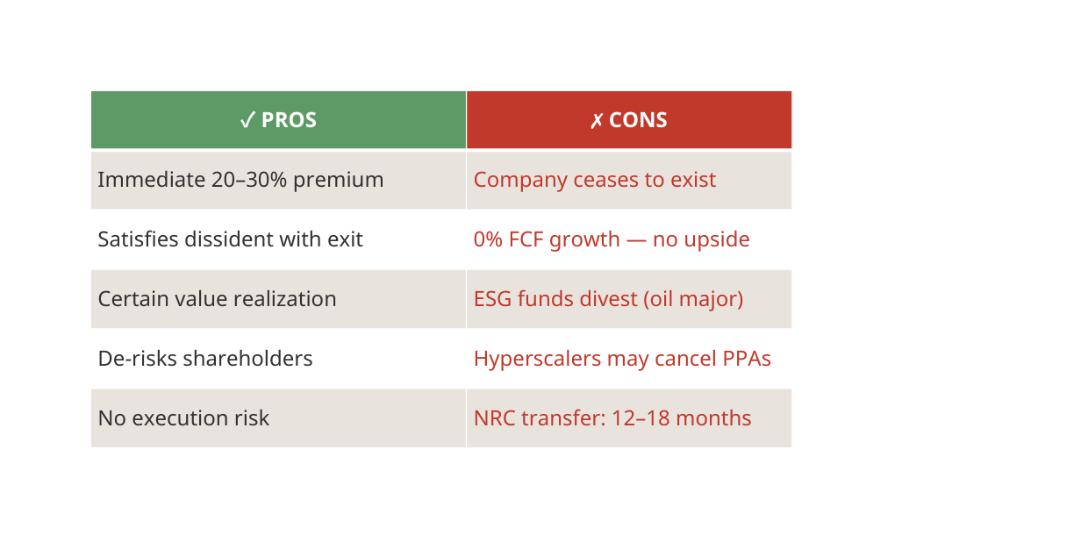
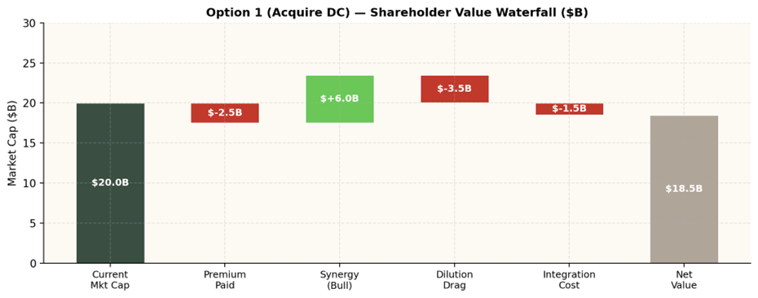
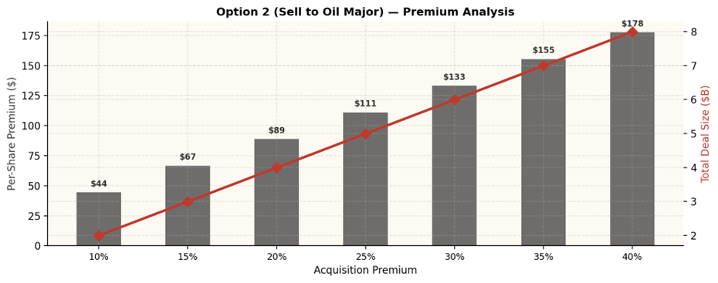
Market & Financial — Options 1 & 2​
Option 1: Acquire Data Center ($4–6B)​
Option 2: Sell to Shell/ExxonMobil​
VERDICT: Option 1 too expensive ($4–6B) and dilutive. Option 2 destroys long-term value. Neither unlocks the AI premium.​

Slide 4
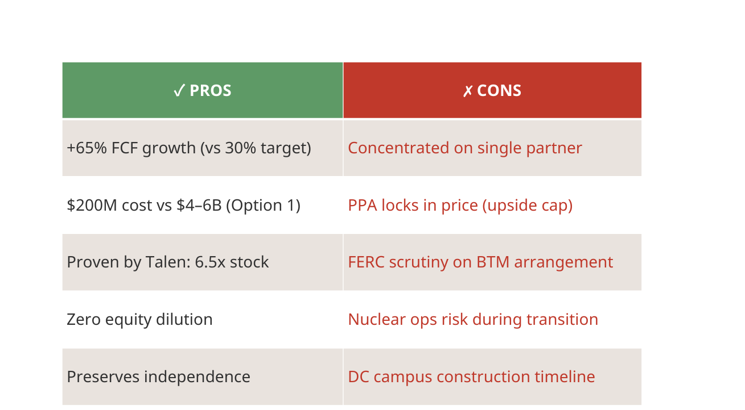
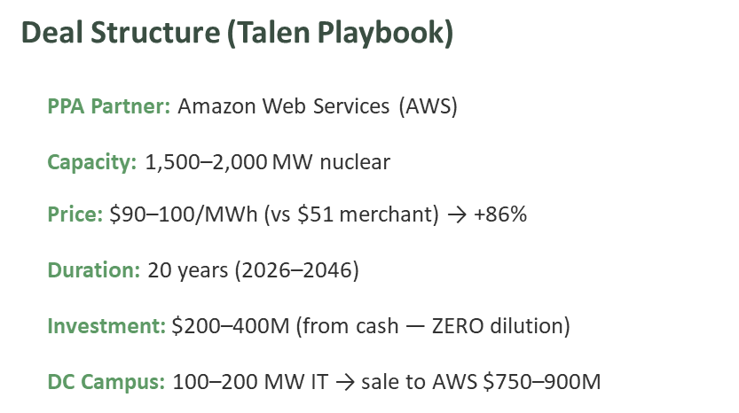
Option 3: JV/PPA with AWS — Our Recommendation

Slide 5
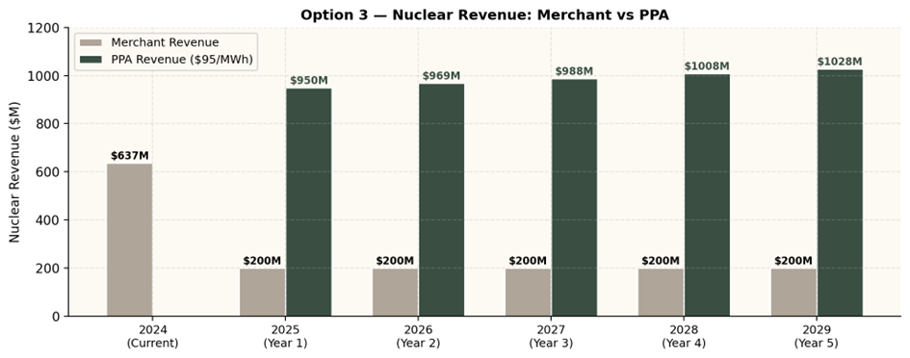
Option 3 — Revenue & FCF Impact

Slide 6
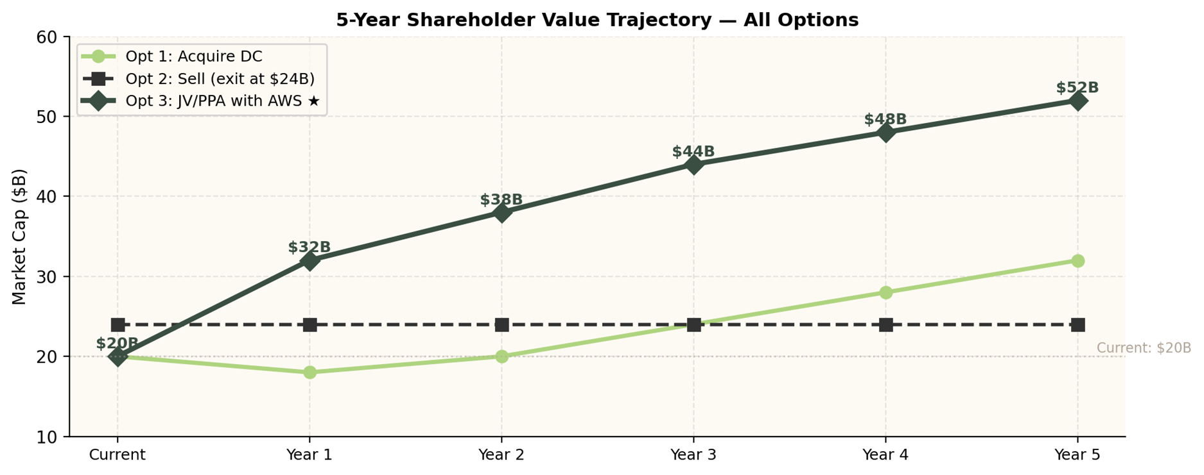

Slide 7
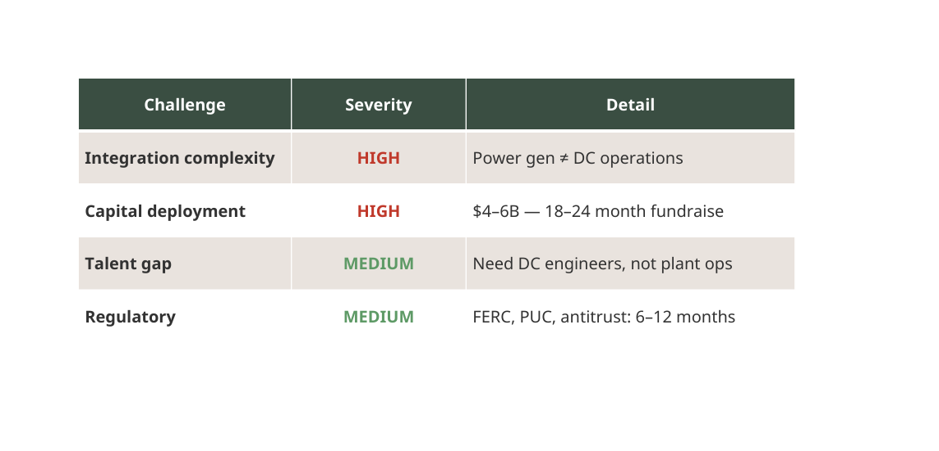
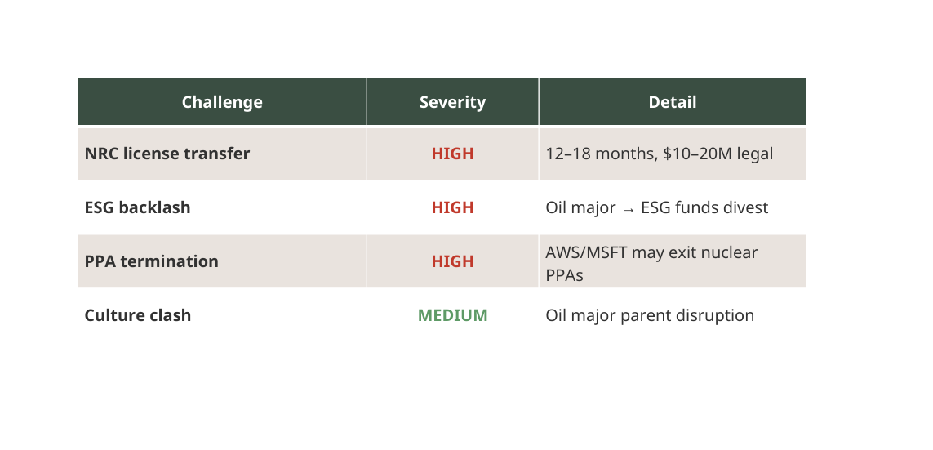

Operational & Execution — Options 1 & 2
Option 1: Acquire DC — Execution
Option 2: Sale — Execution Risks

Slide 8
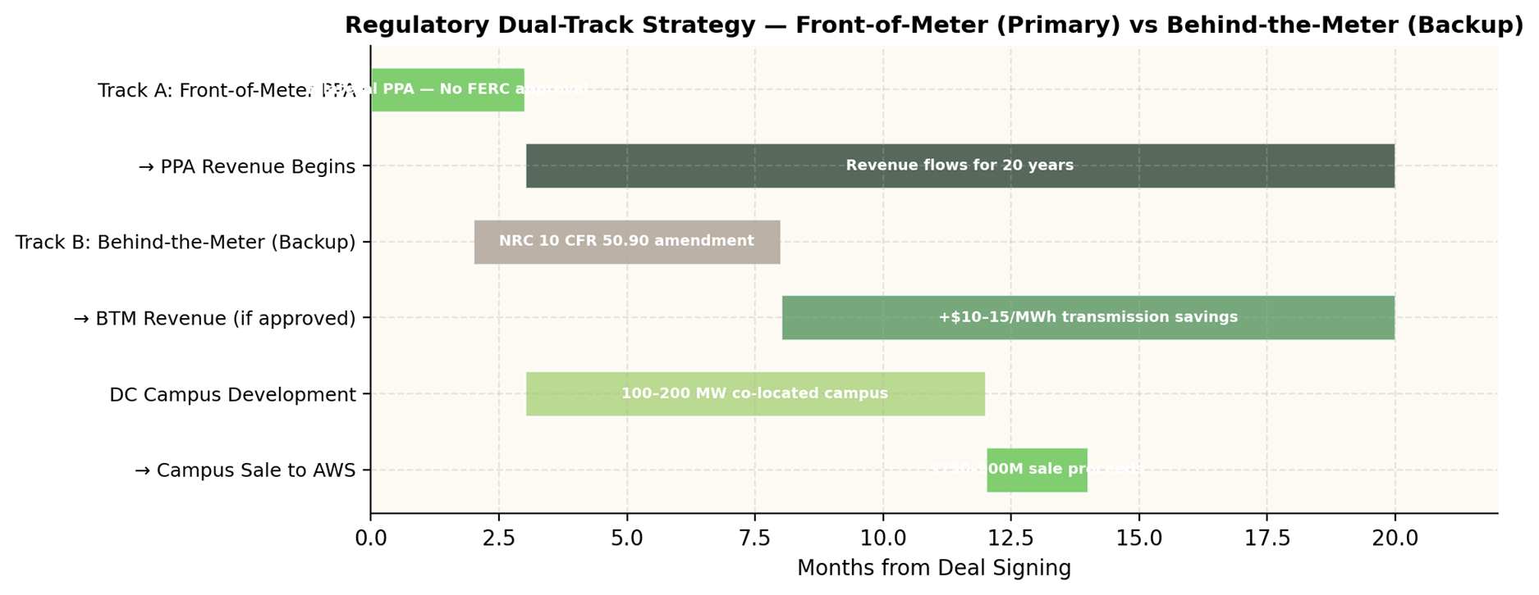
Option 3 — Execution Roadmap

Slide 9
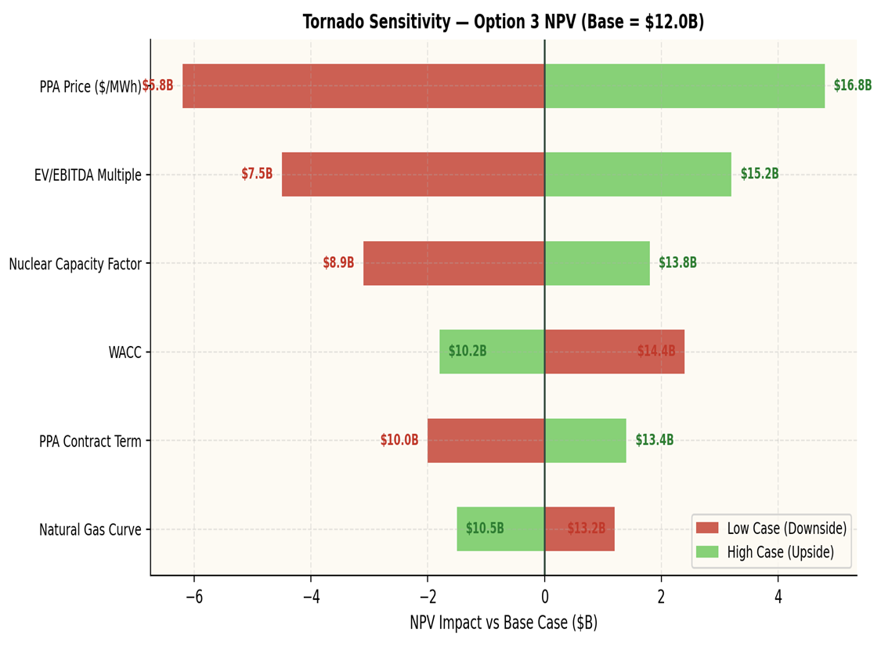
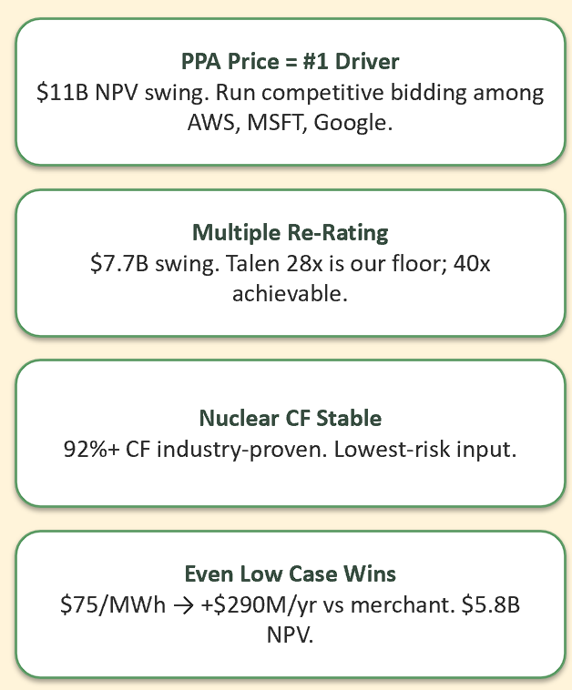
Sensitivity Analysis — What Drives Value
Key Takeaways

Slide 10
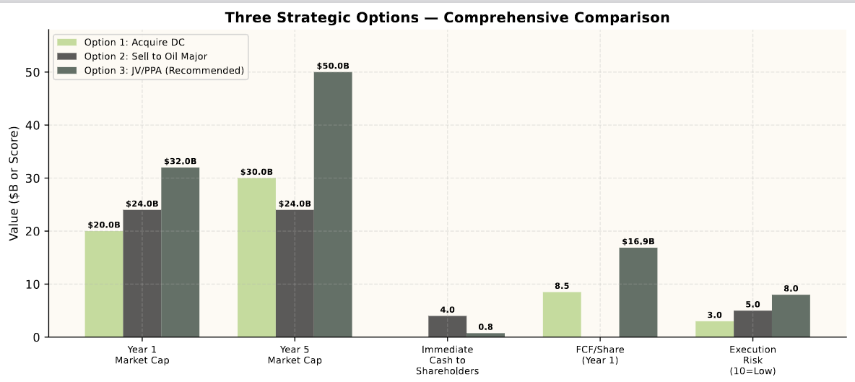
Comparative Analysis — All Three Options

Slide 11
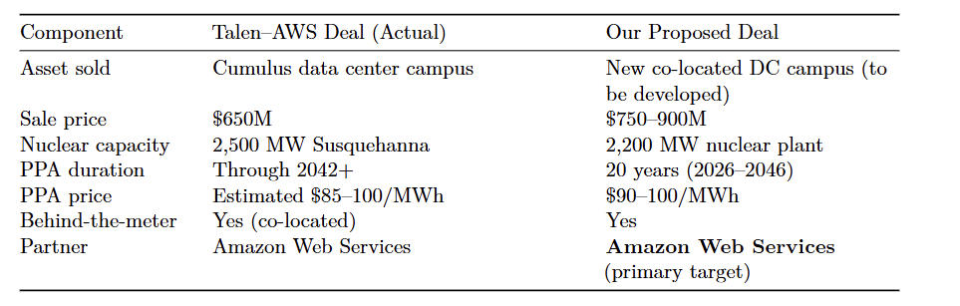
Deal

Slide 12
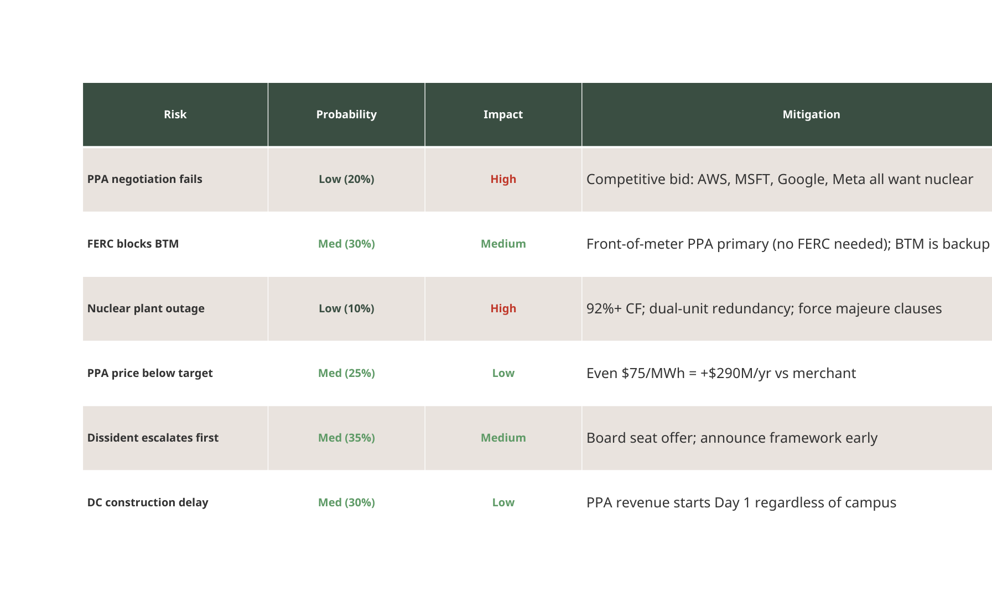
Risk Assessment & Mitigation

Slide 13
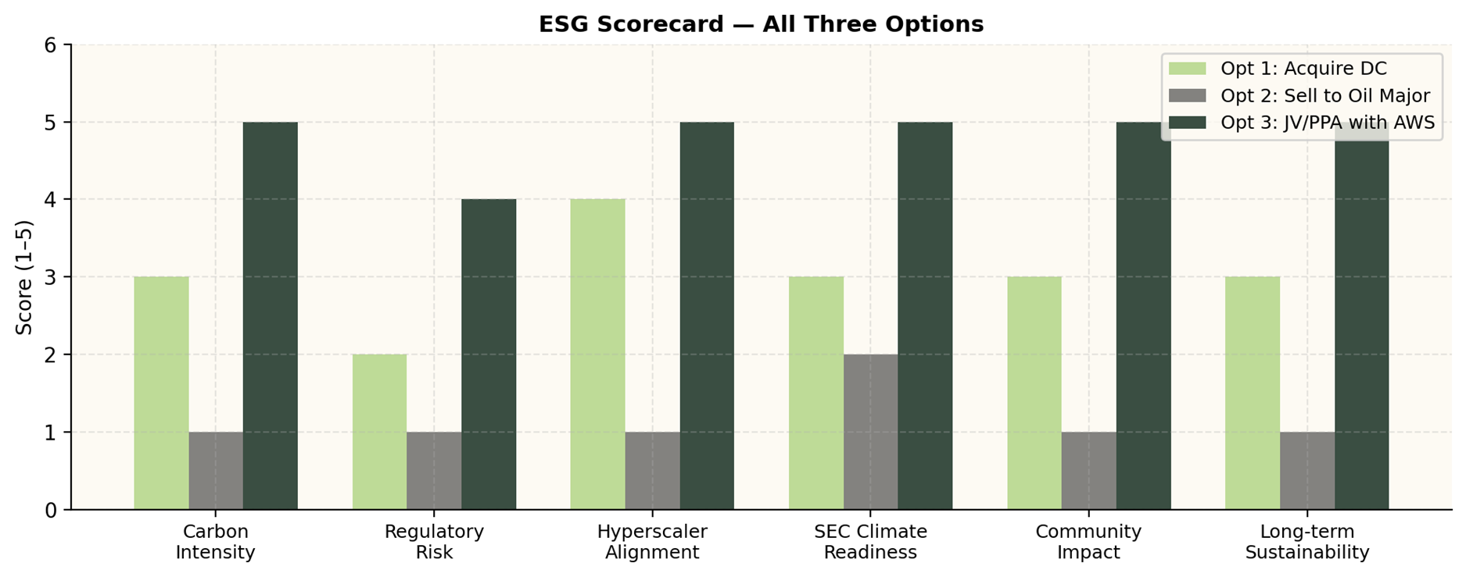

ESG & Sustainability

Slide 14
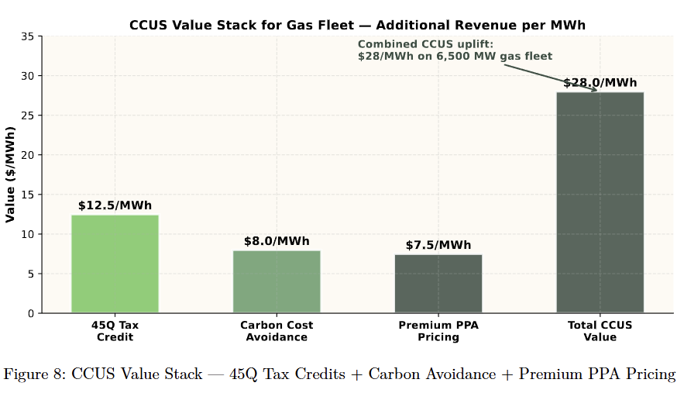
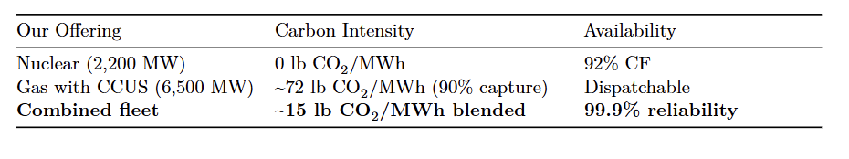
Risk Assesment & Solution

Slide 15
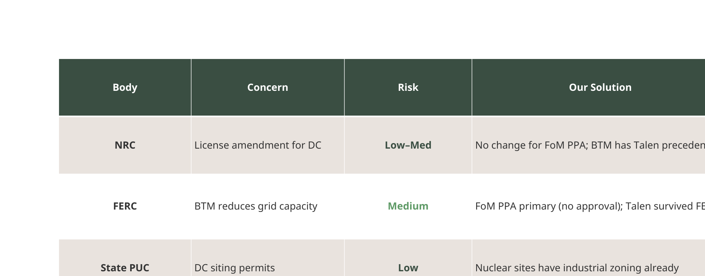
Nuclear Regulatory & Risk Management

